Slide 1
Designing Systematic and Center-Specific Metrics to Foster Innovation
Ajay Israni, M.D., M.S.
Deputy Director, Scientific Registry of Transplant Recipients
Associate Professor of Medicine, Nephrology Division, Hennepin County Medical Center,
Adjunct Faculty, School of Public Health,
University of Minnesota

Slide 2
Disclosure Information AASLD/ ILTS Transplant Course Ajay Israni, MD, MS
I have no financial relationships to disclose
and
I will not discuss off label use and investigational use in my presentation

Slide 3
Outline
Introduction to the Scientific Registry of Transplant Recipients (SRTR)
Use of Program Specific Reports (PSRs) and OPO-Specific Reports (OSRs)to Foster Surgical Innovation
Program Specific Reports: Futility vs. Innovation
Program Specific Reports: Fostering Randomized Trials

Slide 4
Outline
Introduction to the Scientific Registry of Transplant Recipients (SRTR)
Use of Program Specific Reports (PSRs) and OPO-Specific Reports (OSRs)to Foster Surgical Innovation
Program Specific Reports: Futility vs. Innovation
Program Specific Reports: Fostering Randomized Trials

Slide 5
Role of the SRTR in Organ Transplantation
Secretary
of HHS
HRSA
DOT
OPTN
Transplant
Centers
---------
OPO’s
SRTR
CMS
STAC
Candidates
& Recipients
Living
Donors
Investigators
& the Public

Slide 6
History of SRTR Contractors
Prior to 2000: UNOS
2000-2010: Arbor Research Collaborative for Health
2010 – present: Minneapolis Medical Research Foundation

Slide 7
SRTR Senior Staff
SRTR
Director: Bertram Kasiske, MD
Deputy Director: Ajay Israni, MD, MS
Biostatistics and Epidemiology
Operations Director: Jon Snyder, PhD
Biostatistics: Nicholas Salkowski, PhD, Jiannong Liu, PhD
Kidney
Arthur Matas, MD
Dorry Segev, MD
Liver-Intestine
Ray Kim, MD
Jack Lake, MD
Lung
Maryam Valapour, MD
Marshall Hertz, MD
Histocompatibility
Howard Gebel, PhD
Pancreas
Raja Kandaswamy, MD
Heart
Monica Colvin-Adams, MD
Pediatrics
Jodi Smith, MD
Health Services
Mark Schnitzler, PhD
Simulated Allocation Modeling
Diwakar Gupta, PhD
Sommer Gentry, PhD
Dorry Segev, MD
Notes:
Many of them are from the UMN and MMRF, I’ll explicitly point out others are from other institutions. If you keep this figure in mind, the next figure will show the academic affiliations of these Senior Staff members.

Slide 8
Academic Organizational Chart
HCMC/ University of Minnesota
HCMC/ University of Minnesota
U of Minnesota
Johns Hopkins
Stanford U
U of Minnesota
U of Minnesota
Emory
U of Minnesota
U of Minnesota
U of Washington
St Louis U
U of Minnesota
Naval Academy
Johns Hopkins

Slide 9
SRTR Activities as per Final Rule Reporting Requirements
…data shall include the following measures of inter-transplant program variation:
risk-adjusted total life-years pre- and post-transplant,
risk-adjusted patient and graft survival rates …
risk-adjusted waiting time, and
risk-adjusted transplantation rates,
…as well as data regarding patients…who were inappropriately kept off a waiting list or retained on a waiting list.
Final Rule implemented in 2000

Slide 10
Role of the SRTR in Quality Improvement: Creating Program Specific Reports (PSR)
OPTN Data
Other Data
SRTR
UM-KECC
PSR
PSR
Other
CQI Tools
RFI
OPTN
CMS
OPTN
MPSC
Public
Release
Center
Only
Insurance
Provider
Notes:
UM-KECC: University of Michigan Kidney Epidemiology and Cost Center

Slide 11
Outline
Introduction to the Scientific Registry of Transplant Recipients (SRTR)
Use of Program Specific Reports (PSRs) and OPO-Specific Reports (OSRs)to Foster Surgical Innovation
Program Specific Reports: Futility vs. Innovation
Program Specific Reports: Fostering Randomized Trials

Slide 12
Recommendations from the Consensus Conference on Transplant Program Quality and Surveillance Arlington, VA February 13-15, 2012
Notes:
OPTN and SRTR cosponsored a consensus conference in Arlington, Virginia, February 13-15, 2012. The purpose of the conference was to examine the methods SRTR uses in the surveillance of solid organ transplant programs and to make recommendations for improvements. Presentations at this conference addressed current uses and future needs of the PSRs and unintended consequences of PSRs.

Slide 13
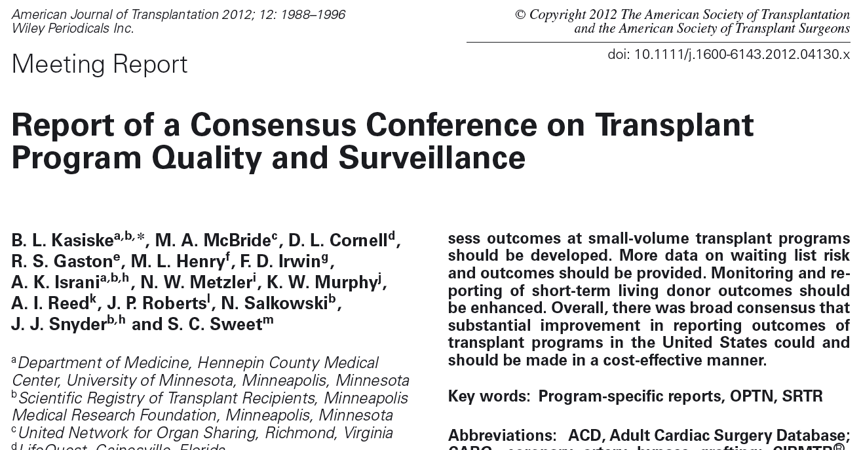
I.4. Provide transplant centers with tools like the cumulative sum (CUSUM) technique and tools to perform subgroup analysis to facilitate Quality Assessment and Performance Improvement.

Slide 14
CUSUM: Released Monthly to All Transplant Programs since July 2013

Slide 15
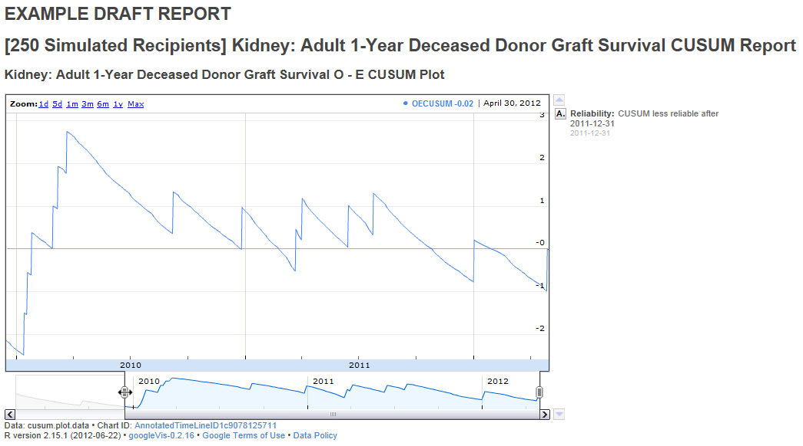
CUSUM Recipient Survival Reports: Selecting the Time Period
Sliders on the bottom of the figure can limit the view to a specific time period

Slide 16
II.2. Identify centers that manage high-risk patients and donors well

Slide 17
Examples
Which programs transplant high MELD patients?
OPTN Liver Committee:
Which programs utilize DCD organs?
Determine which programs have superior post-transplant outcomes, including both graft and patient survival, with primary DCD liver transplants
.

Slide 18
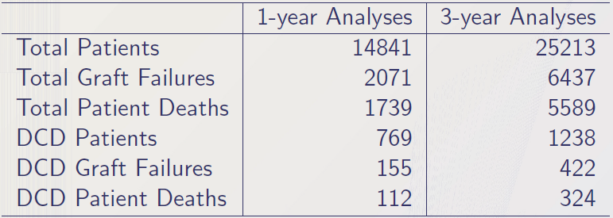
Compare Practices at Best Centers Utilizing DCDs
There were 84 centers having at least 1 DCD transplant in the 1- and 3-year analyses.
Results only show the centers having performed at least 9 DCD transplants in the top 20 lists
Comparison of practices at best centers may require validation by reviewing practices at centers with poor outcomes
Notes:
For the 1-year survival analyses: adult liver transplant recipients who underwent 1st liver transplant between January 1, 2008, and December 31, 2010.
For the 3-year survival analyses: adult liver transplant recipients who underwent 1st liver transplant between January 1, 2004, and December 31, 2008.

Slide 19
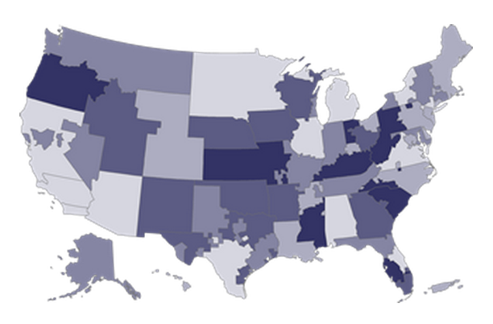
New OPO-Specific Reports (OSRs)
First Released: January 2014
Spring 2014 Release: June 17, 2014

Slide 20
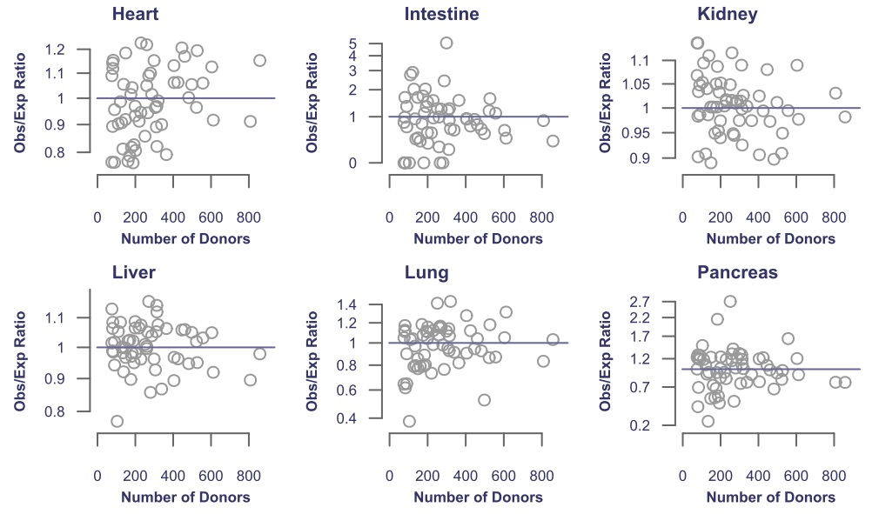
Observed/ Expected, Adjusted Yield by Organ, 12/1/2011-12/31/2012
27 OPOs
22
33
31 OPOs
36
25
31
29
30
27
29
28
Israni et al., WTC, 2014

Slide 21
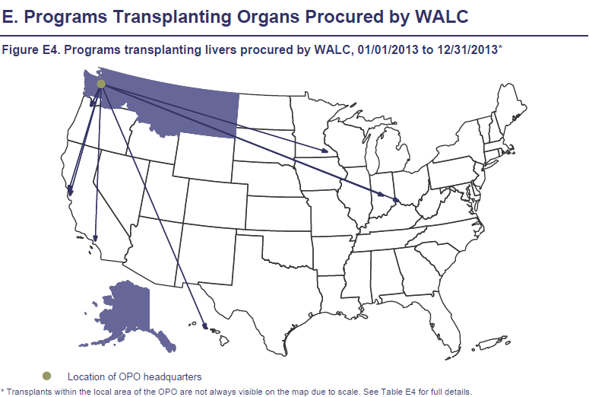
Where are the Livers Going? How far?

Slide 22
Outline
Introduction to the Scientific Registry of Transplant Recipients (SRTR)
Use of Program Specific Reports (PSRs) and OPO-Specific Reports (OSRs)to Foster Surgical Innovation
Program Specific Reports: Futility vs. Innovation
Program Specific Reports: Fostering Randomized Trials

Slide 23
Adjusting for risk: What is the right balance?
Too Much
Not Enough
↑ Futile Transplants
↓ Recipient Access
↓Organs
↓ Donor Utilization
Notes:
Tradeoffs in the balance

Slide 24
II.3. Collect more reliable organ-specific data on coronary heart disease (e.g. revascularizations), peripheral vascular disease (e.g. revascularizations and amputations),diabetes mellitus, ZIP code socioeconomic status, donor risk and ventricular assist devices

Slide 25
Overview of Data Advisory Committee (DAC) Charge/Functions
The DAC will seek broad input in developing a long term vision for the OPTN/SRTR data including:
process for the identification of OPTN data,
methods of collection,
types of products to be supported
Advise the OPTN Board of Directors on collecting data
pertinent to the operation of the OPTN & SRTR and
further the state-of-the-art in SOT including
continuous quality and patient safety improvements

Slide 26
Data Advisory Committee Members
Name | Role
Charles Alexander | Chair
Joseph Kim | Vice-Chair
Sandy Feng * | Member
Stuart Sweet | Member
Jesse Schold | Member
Yael Coppleson | Member
James Wynn | Member
Ian Jamieson | Member
Name | Role
Maryl Johnson | Member
Alan Leichtman | Member
Richard Hasz | Member
Alexandra Glazier | Member
Robert Merion* | Member
Mike Peterson | Member
Monica Lin | HRSA Ex Officio
Shannon Dunne | HRSA Ex Officio
Support staff from the UNOS & the SRTR

Slide 27
Outline
Introduction to the Scientific Registry of Transplant Recipients (SRTR)
Use of Program Specific Reports (PSRs) and OPO-Specific Reports (OSRs)to Foster Surgical Innovation
Program Specific Reports: Futility vs. Innovation
Program Specific Reports: Fostering Randomized Trials

Slide 28
II.1. Consider protecting innovation by excluding patients who are in approved protocols from PSR models in identifying underperforming centers

Slide 29
Report of a Consensus Conference on Transplant Program Quality & Surveillance
Failure to adequately account for risk in PSRs may discourage centers from using innovative treatments.
Establishing a national body, e.g. an ad hoc subcommittee of the MPSC, to approve innovative treatment protocols that warrant special consideration
Ad hoc subcommittee would prospectively review and approve protocols and/or individual patients for exclusion:
Process should be transparent; the numbers of patients excluded and the reasons for exclusion should be available for each transplant center
Outcomes for patients treated under this exclusion should be reported separately
Kasiske, et al. Am J Transplant 2012; 12:1988

Slide 30
OPTN/UNOS Ad Hoc Committee on Program-Specific Reports
Report to the Board of Directors
June 24-25, 2013
Richmond, VA
John R. Lake, MD, Chair

Slide 31
OPTN/UNOS Ad Hoc Committee on PSRs
Committee | Role | Support Staff | Org.
John R. Lake* | Chairman | Christopher McLaughlin | HRSA
Sandy Feng* | Member | Monica Lin | HRSA
Tom Gonwa | Member | Bertram L. Kasiske | SRTR
Ken Andreoni | Member | Jon Snyder | SRTR
Larry Hunsicker | Member | Nicholas Salkowski | SRTR
Robert Merion* | Member | David Zaun | SRTR
Jennifer Milton | Member | Tabitha Leighton | SRTR
Ron Potts | Member | John Roberts | UNOS Pres.
Thomas Hamilton | Member (CMS) | Jacqueline O’Keefe | UNOS
Karen Tritz | Member (CMS) | Erick Edwards | UNOS
 |  | Robert Hunter | UNOS
 |  | David Kappus | UNOS
Kasiske, et al. Am J Transplant 2012; 12:1988

Slide 32
Report from OPTN/UNOS Ad Hoc Committee on PSRs
There was not a lot of support for using a standard risk patient profile.
More support for allowing the centers to define which patients are high-risk outside of the criteria currently collected for the PSR because centers can identify high risk patients better than the model.
Subcommittee discussed rolling out the self-identification of high risk patients as a pilot program first, but this option requires more discussion - not yet a formal recommendation.
But, the Subcommittee noted that there are constraints with the self-identification of high risk patients, including variation among centers regarding what variables indicate high risk, and requiring additional data collection.

Slide 33
Possible PSR Exclusion: Questions
How is a protocol agreed upon as being acceptable for exclusion?
Does a protocol need to have scientific merit?
Who decides?
Does there need to be some type of DSMB and stop rules?
Is there a need for a consent process, who approves the consent?
Is there a limitation to the size of the center that can participate?
Is there a limitation on the number of patients (% of population) that can be entered in by a center?
How can “gaming” be avoided?

Slide 34
Possible PSR Exclusion: Path Forward
There would need to be a “true” research protocol, e.g. a government-registered clinical trial.
The MPSC would need to determine whether the experimental protocol qualified for exclusion.
PSRs would start with the total cohort, but patients in research protocols would be excluded.
Centers would choose whether to exclude patients.
Data forms would collect information from the experimental protocols at the time of transplant.

Slide 35
Conclusion
Possible to have Program Specific Metrics to Foster Innovation
Utilize metrics to identify innovative centers
Compare best practices at centers and OPOs,
Utilize Data Advisory Committee to identify new OPTN data, collection methods
Exclude patients who are in approved protocols from PSR

Slide 36
Acknowledgments
SRTR
Bertram Kasiske, MD
Jon Snyder, PhD, MS
Nicholas Salkowski, PhD
Jack Lake, MD
SRTR Analysts and Liaisons

